Slide 1
















Creating a Sustainable Future
Team X Presentation

Slide 2
TEAM X
RIM BENJABALLAH
TEK-UP
MOHAMED OUSSEMA DAKHLI
TEK-UP
hamdi zeddini
ESPRIT
BAHA ROJBI
ESPRIT

Slide 3


SUSTAINABLE DEVELOPMENT GOALS
SDG 11
Sustainable cities and Communities
Goal 11 is about making cities and human settlements inclusive, safe, resilient and sustainable. Cities represent the future of global living.
SDG 12
Responsible Consumption and Production
Ensure sustainable consumption and production patterns

Slide 4

INTRODUCTION AND PROBLEM STATEMENT

Slide 5
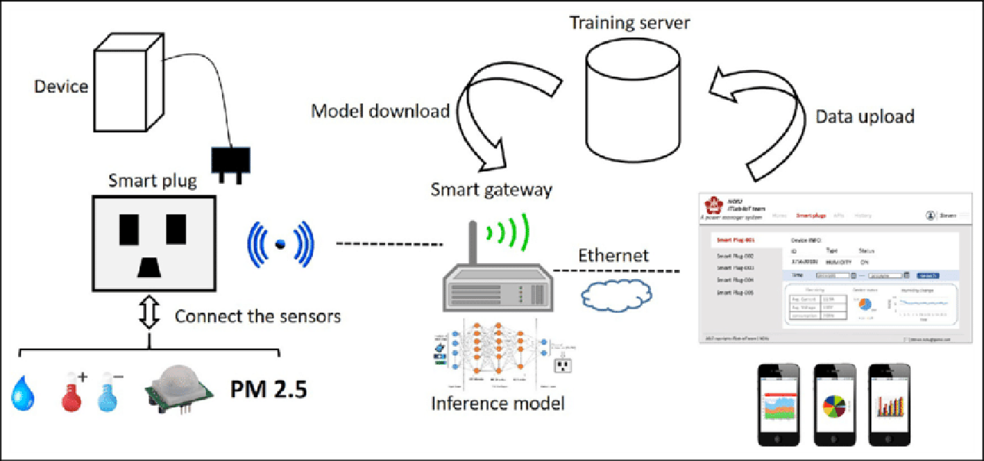
SMART OUTLET

Slide 6
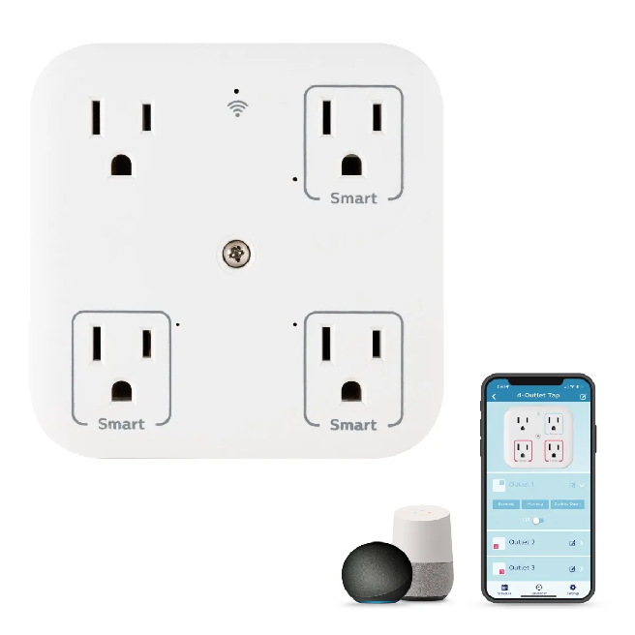
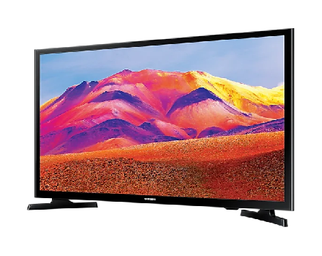
SMART OUTLET
Power consumption sensor
Remote On/Off switch

Slide 7
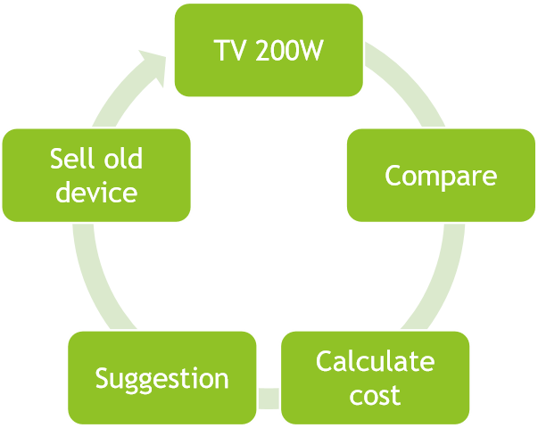
RECOMMENDATION MODEL
Example
New TV (180W)
Price 600 TND
Saving 0.091 TND/h
Covering duration 9 months
Sell your old to another user

Slide 8
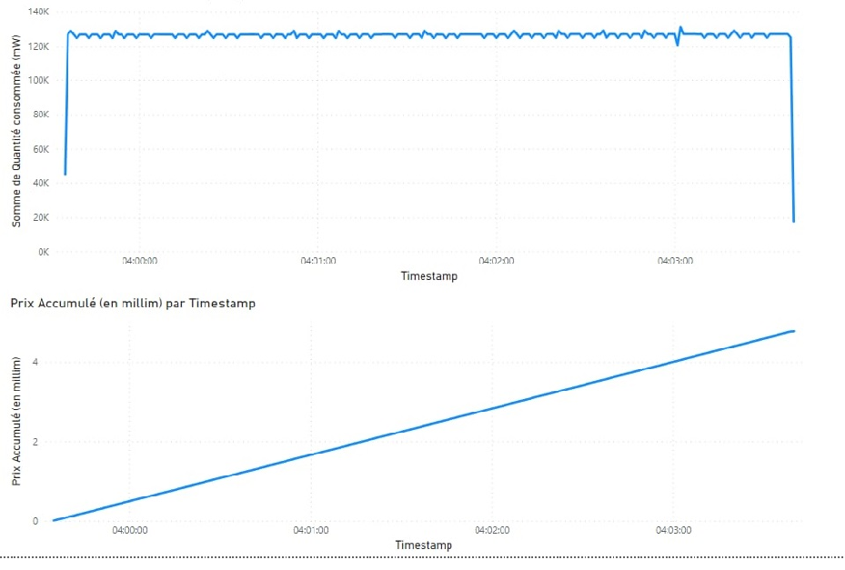
REAL TIME CONSUMPTION MONITORING

Slide 9
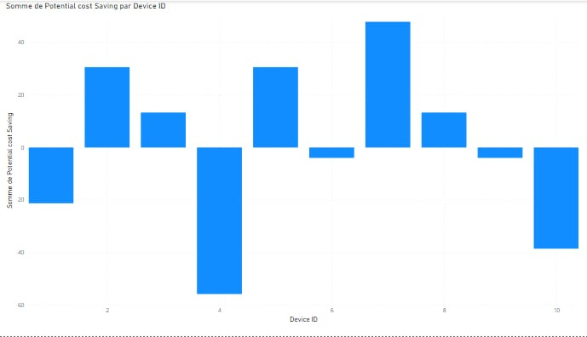
COMPARISON AND RECOMMENDATION

Slide 10
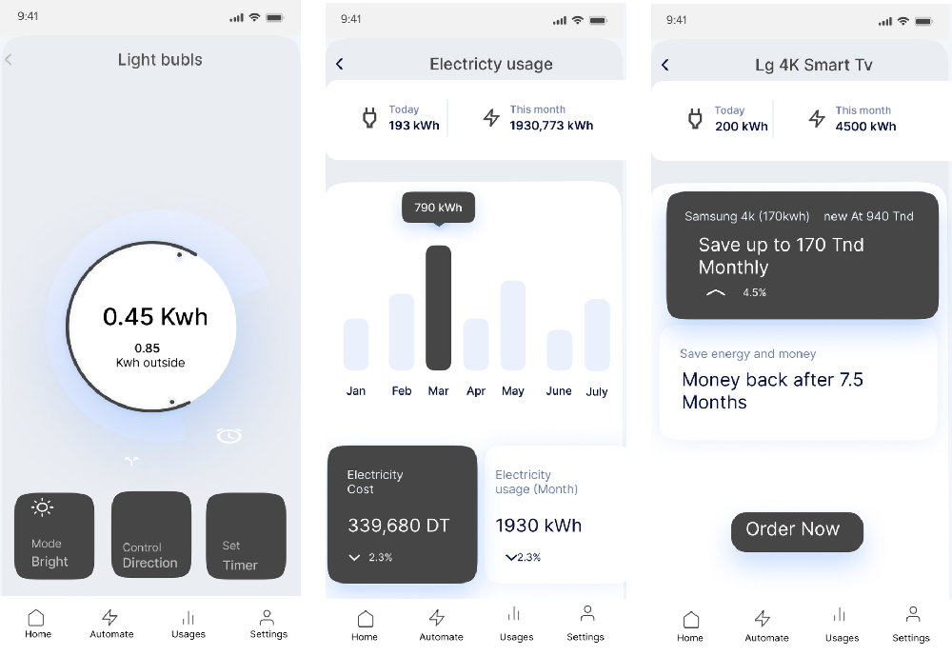
USER INTERFACE

Slide 11



Key Features
Power management
User application
Consumption Reduction
Product recommendation
Marketplace

Slide 12
APPLICATIONS
Domicile
Refrigerator
TV
Air conditioner
Dish / Wacher machine
Industry
Pumps
Heat / Cold generators
Compressors
AC motors
Lights
Divers

Slide 13
Cost of Implementation:
40D FOR THE OUTLET
CLOUD PAY AS YOU GO
80 D CENTRAL SYSTEM FOR HOME USERS

Slide 14
value proposition
Potential Cost Savings:
lower the probability of power outrages
Environmental Sustainability
reduces gas pollution

Slide 15
Thank you!

